Slide 1




DataWare
Data analytics solutions
A Presentation on
Climate Change Belief Analysis 2022
#Non-Believer
#Believer

Slide 2






Members
Jennifer Mukami
Falalu Barde
Isreal Ezema
Gabriel Asiegbu
Edward Ogbei
DataWare
Data analytics solutions
2
https://data-ware.io/

Slide 3





Contents
Introduction
An overview, problem statement, data set
Model Performance
F1-Macro, F1_Accuracy, F1-Weighted
Exploratory Data Analysis Insights from the dataset
Best Performance
Logistic Regression
Data Processing
Text processing, Feature extraction
Streamlit
App
Modelling
Models
Conclusion
Conclusion and Recommendation
DataWare
Data analytics solutions
3
https://data-ware.io/

Slide 4
4
“
When the well is dry, we know the worth of water”
– Benjamin Franklin
DataWare
Data analytics solutions
4
https://data-ware.io/

Slide 5
Introduction
Overview
Many companies would like to determine how people perceive climate change and whether or not they believe it is a real threat.
Problem Statement
?
We are looking to Empower the marketing sector of Eco-Friendly Companies, helping them maximise productivity, driving profitability by knowledge of the demand & Supply on her goods & Services.
Data Set
The collection of this data was funded by a Canada Foundation for Innovation JELF Grant to Chris Bauch, University of Waterloo.
DataWare
Data analytics solutions
5
https://data-ware.io/

Slide 6






Introduction
Class Description and Tools
1: Pro
- 1: Anti
The tweet does not believe in man-made climate change
The tweet supports the belief of man-made climate change
0: Neutral
The tweet neither supports nor refutes the belief of man-made climate
2: News
The tweet links to factual news about climate change
DataWare
Data analytics solutions
6
https://data-ware.io/

Slide 7

Exploratory Data Analysis
02
Categorical
Number of observations
15,819
01
Numeric
00
Missing Data
DataWare
Data analytics solutions
7
https://data-ware.io/

Slide 8
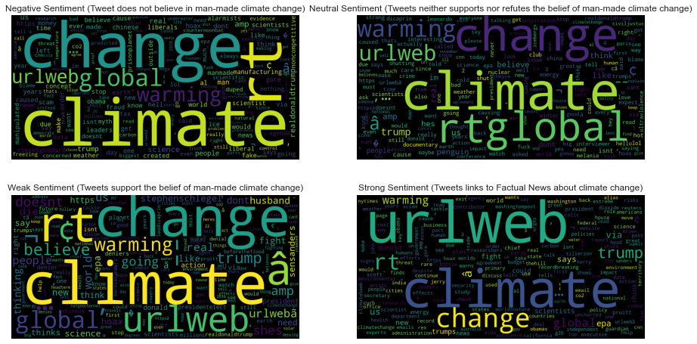

Exploratory Data Analysis
Word Cloud
Negative Sentiment
Tweet does not believe in man-made climate change
Neutral Sentiment
Tweets neither supports or refutes the belief of man-made climate change
Weak Sentiment
Tweet supports the belief in man-made climate change
Strong Sentiment
Tweets links to factual news about climate change
DataWare
Data analytics solutions
8
https://data-ware.io/

Slide 9

Data Processing
Text Preprocessing
Feature Extraction
All tweets were cleaned up by removing the following characteristics:
Line breaks
URL’s
Numbers
Capital letters
Punctuation
Maximum word frequency
Minimum word frequency
ngram range
Stop words
CountVectorizer
TfidVectorizer
DataWare
Data analytics solutions
9
https://data-ware.io/

Slide 10

Modelling
Models
01
01
Multinomial Naive Bayes - Base Model
04
04
02
02
Complement Naive Bayes
Logistic Regression
05
03
05
03
Linear Support Vector Classifier
Support Vector Classifier
DataWare
Data analytics solutions
10
https://data-ware.io/

Slide 11
Model Performance
Model Testing Scores
DataWare
Data analytics solutions
11
https://data-ware.io/

Slide 12


Best Model
Best Model Resolution
Logistic
Regression
66%
F1-Macro
75.4%
Accuracy
DataWare
Data analytics solutions
12
https://data-ware.io/

Slide 13
Streamlit
Streamlit App
ScreenShot goes here
Click here for a demonstration
DataWare
Data analytics solutions
13
https://data-ware.io/

Slide 14
Conclusion
Conclusion
In conclusion, we can thus infer that Logistics Regression classifier performed best both in the training and validation phase with an accuracy score.
Recommendation
The marketing team(s) for Eco-Friendly Companies can move into integrating this model to their focused market domain, gain insight on market behaviour, maximise productivity, driving profitability by knowledge of the demand & Supply on her goods & Services.
DataWare
Data analytics solutions
14
https://data-ware.io/

Slide 15




Thank you!
Questions?
www.data-ware.io
hello@data-ware.io
http://Streamlit page (hyper link)
DataWare
Data analytics solutions
15
https://data-ware.io/

